Slide 1

DEEPFAKE IMAGE DETECTION
DEPARTMENT OF COMPUTER SCIENCE ENGINEERING
NATIONAL INSTITUTE OF TECHNOLOGY PATNA
Under the supervision of :
Dr. Rajib Ghosh
Prepared by group 7 :
Vineet Raj 2106019
Aditya Kumar 2106011
Rupesh 2106005

Slide 2








OUTLINE
INTRODUCTION
PROBLEM STATEMENT
OBJECTIVES
PROPOSED METHODOLOGY
DATASET
REFERENCES

Slide 3


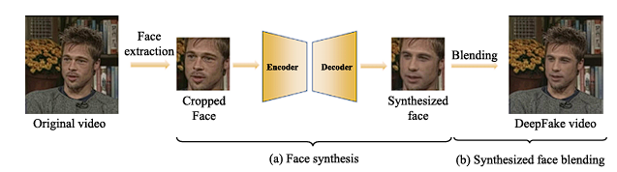
INTRODUCTION
What is deepfake ?
Deepfake refers to synthetic media , images, that are created or altered using advanced artificial intelligence techniques, particularly deep learning algorithms.

Slide 4
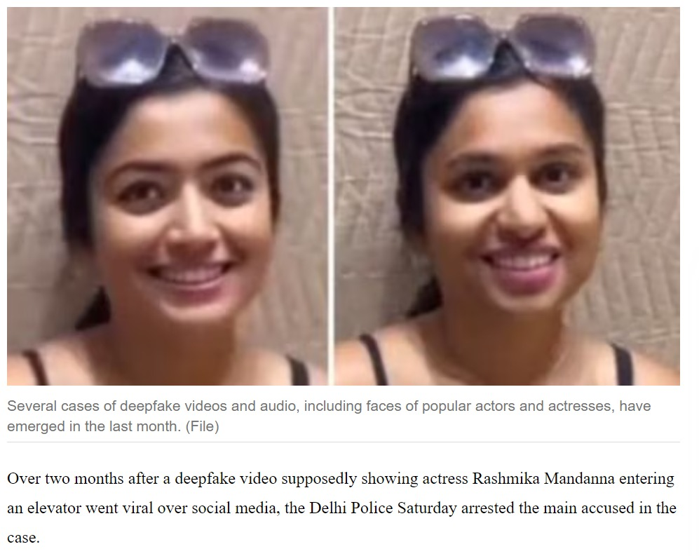
PROBLEM STATEMENT
MISINFORMATON
Deepfakes can be used to create convincing
fake videos or images that can spread false information .
PRIVACY CONCERN
create realistic fake videos or images of
individuals without their consent.
FRAUD
creating fake videos or images for financial scams
or to impersonate someone for malicious purposes.
SECURITY CONCERN
create fake content for social engineering attacks, such as phishing or spreading malware.
FAKE
REAL

Slide 5


OBJECTIVE
Deepfake detection refers to the process of identifying and verifying whether a piece of media content, typically videos, has been manipulated or generated using artificial intelligence techniques.
Accuracy: Develop deepfake detection methods with high accuracy to reliably distinguish between authentic and manipulated media content.
Robustness: Ensure that detection methods remain effective against evolving deepfake techniques by continuously updating and improving algorithms.
Accessibility: Make deepfake detection tools and technologies accessible to a wide range of users, including researchers, journalists, and social media platforms, to combat the spread of misinformation effectively.

Slide 6
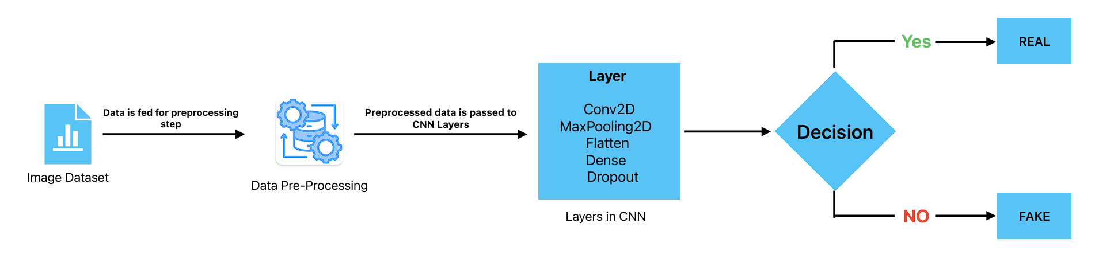
PROPOSED METHODOLOGY
Proposed Model

Slide 7


PROPOSED METHODOLOGY
Binary Granularity
Intrinsic Granularity:
Fine-grained Analysis: Conduct an in-depth analysis of specific characteristics and artifacts present in deepfake content, such as inconsistencies in facial expressions, unnatural lip movements, or irregularities in lighting and shadows.
Rule-based Systems: Develop rule-based systems or heuristic approaches that leverage domain-specific knowledge to identify subtle cues indicative of deepfake manipulation.

Slide 8
PROPOSED METHODOLOGY
Extrinsic Granularity:
Contextual Information: Incorporate contextual cues and metadata surrounding the media content, such as source credibility, social network interactions, and historical patterns of dissemination.
Cross-modal Verification: Utilize information from multiple modalities, including text, audio, and metadata, to corroborate the authenticity or detect inconsistencies across different forms of media.

Slide 9
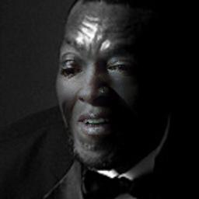

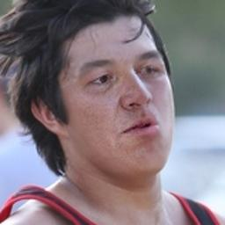
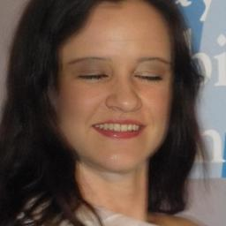
DATASET
FAKE IMAGES FROM DATASET

Slide 10
DATASET(Celeb df)
Image Size = 128,128
Training Parameters :
1) Number of Epochs : 10
2) Loss Function : Binary Cross Entropy
3) Optimizer : Adam
4) Batch Size : 25

Slide 11
DATASET(OpenForensics)
Image Size = 128,128
Training Parameters :
1) Number of Epochs : 20
2) Loss Function : Binary Cross Entropy
3) Optimizer : Adam
4) Batch Size : 64

Slide 12
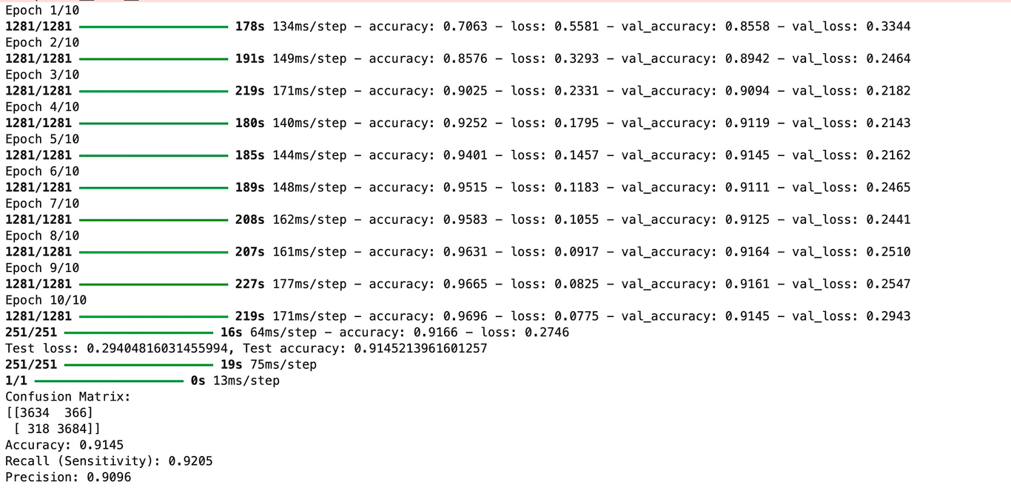
RESULT
DATASET – CELEB DF (V1)

Slide 13
RESULT(Contd..)
BATCH SIZE | 25
EPOCHS | 10
ACCURACY | 92%
RECALL (SENSITIVITY) | 92.05%
PRECISION | 90.96%

Slide 14

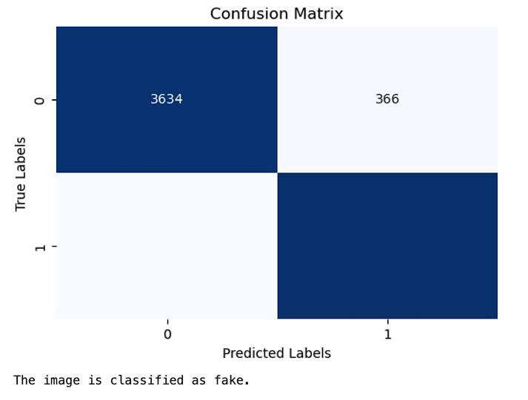


RESULT(Contd..)

Slide 15

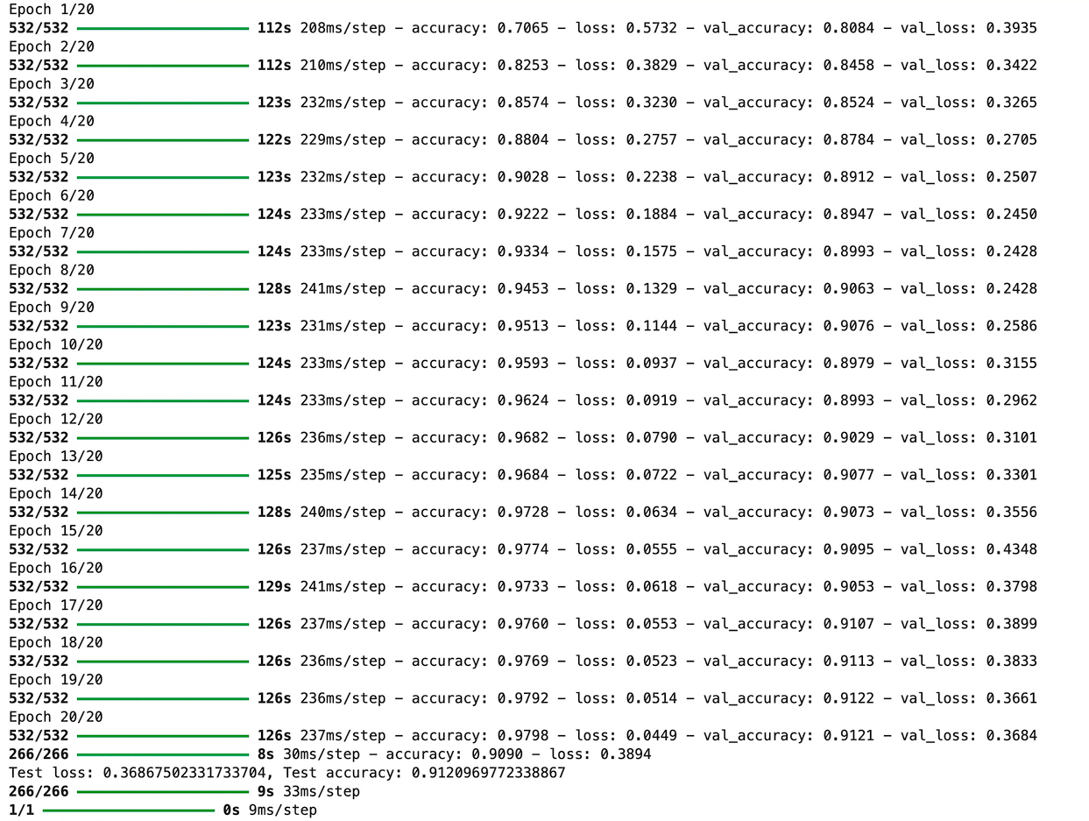
RESULT(Contd..)

Slide 16
RESULT(Contd..)
BATCH SIZE | 64
EPOCHS | 20
ACCURACY | 91.2%
RECALL (SENSITIVITY) | 92.21%
PRECISION | 93.24%

Slide 17
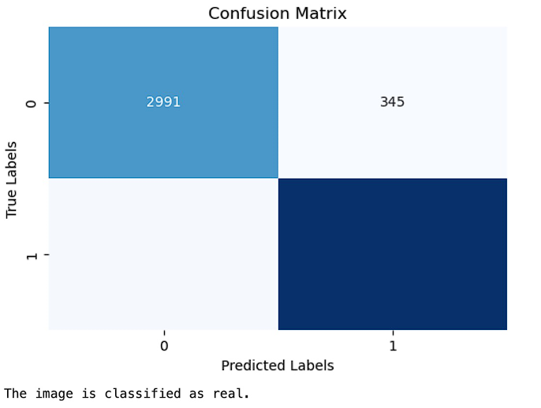


RESULT(Contd..)

Slide 18
REFERENCES
Chen en at a Watching the BiG artifacts: Exposing DeepFake videos via Bi- granularity artifacts
2. D. Güera, E.J. Delp, DeepFake video detection using recurrent neural networks,
in: 2018 15th IEEE International Conference on Advanced Video and Signal
Based Surveillance (AVSS), 2018, pp. 1–6, doi:10.1109/AVSS.2018.8639163.
3. D. Afchar, V. Nozick, J. Yamagishi, I. Echizen, MesoNet: a compact facial video
forgery detection network, in: 2018 IEEE International Workshop on Information
Forensics and Security (WIFS), 2018, pp. 1–7, doi:10.1109/WIFS.2018.8630761

Slide 19
REFERENCES
[1] I. Goodfellow, J. Pouget-Abadie, M. Mirza, B. Xu, D. Warde-Farley, S. Ozair,A. Courville, Y. Bengio, Generative adversarial nets, in: Proceedings ofthe Conference Neural Information Processing Systems (NeurIPS), 2014,pp. 2672–2680.
[2] L. Gao, D. Chen, Z. Zhao, J. Shao, H.T. Shen, Lightweight dynamic conditionalGAN with pyramid attention for text-to-image synthesis, Pattern Recognit. 110(2021) 107384
[38] D.P. Kingma, J. Ba, Adam: a method for stochastic optimization,arXiv preprint arXiv:1412.6980(2014).

Slide 20

THANK YOU

